Slide 1

NYC Taxi Data Analysis: Comparing January 2024 & January 2025
Team Members:
Karthik Vinay Kumar Adari
Yojitha Naga Vaibhavi Uppala
Anuhya Vaagita

Slide 2
Business Problem Statement
Objective:
Analyze NYC taxi data to understand daily demand, hotspot locations, and fare trends.
Why It Matters:
Helps improve resource allocation, optimize pricing strategies, and informs urban planning decisions.
Key Questions:
How do daily trip volumes vary?
Which pickup locations show the highest demand?
How do average fares change over time?
Notes:
Types of Taxis:
Yellow Taxi Cabs
Green Cabs
For-Hire Vechicles
Commuter Vans
Paratransit Vechicles
Yellow Taxicabs:
Yellow taxicabs are the iconic, yellow vehicles that have the right to pick up street-hailing passengers anywhere in New York City. By law, there are 13,587 taxis in New York City and each taxi must have a medallion affixed to it.

Slide 3
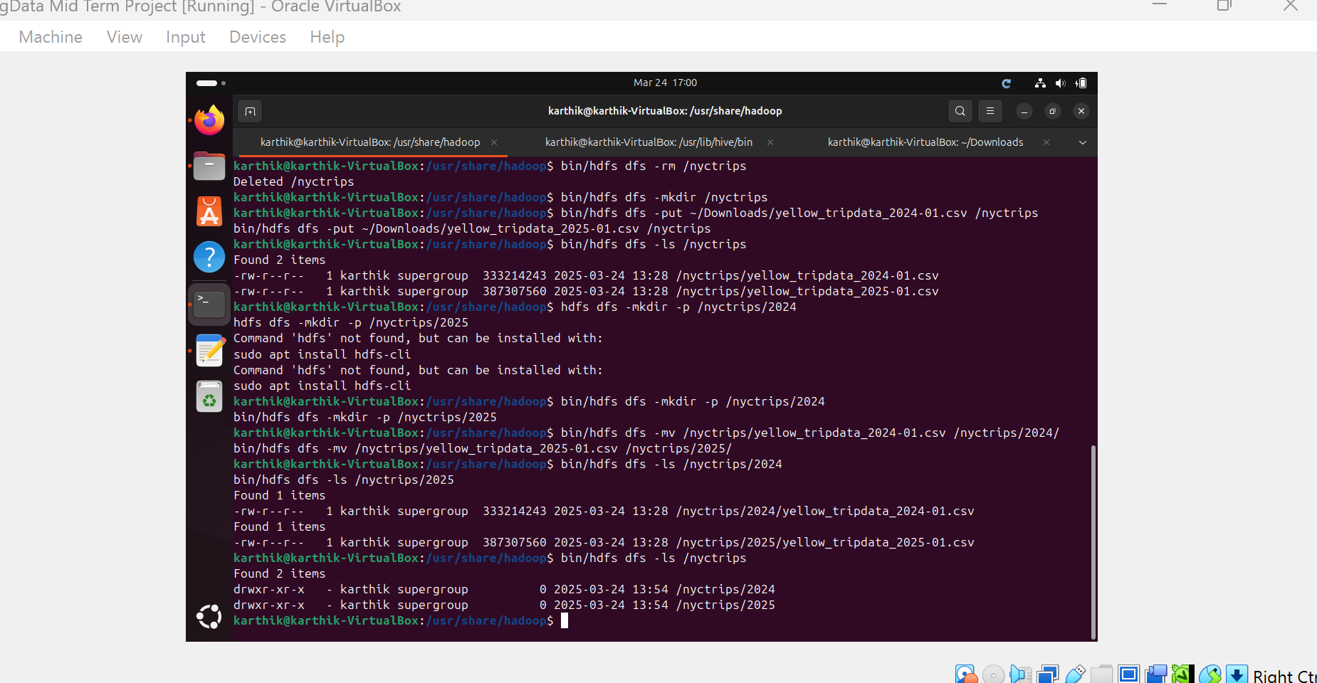
Data Overview
Dataset Description:
NYC Yellow Taxi data for January 2024 and January 2025 (CSV files).
Storage:
Loaded into Hadoop HDFS (organized by year in separate subdirectories).
Dataset Location
https://www.nyc.gov/site/tlc/about/tlc-trip-record-data.page
Notes:
Dataset Location:- https://www.nyc.gov/site/tlc/about/tlc-trip-record-data.page
Dataset size:
2025 – 3475225
2024 - 2964623

Slide 4
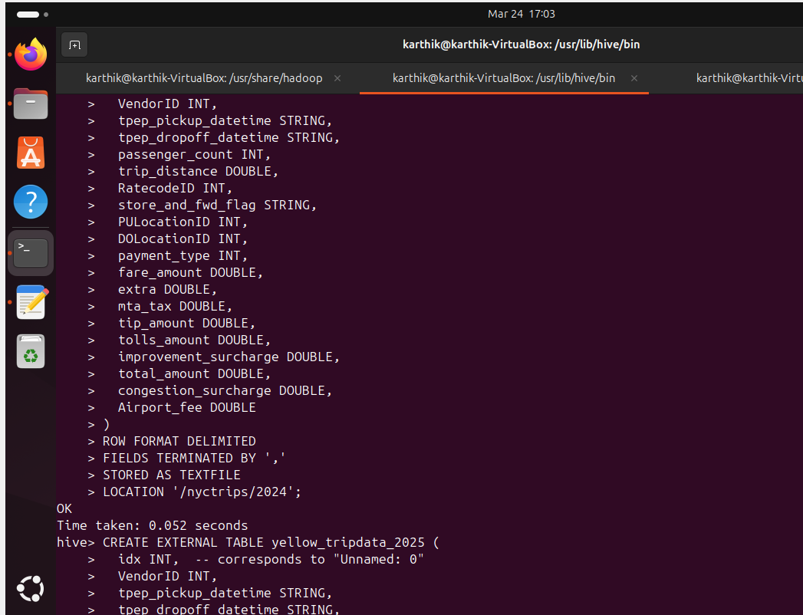
Methodology
Data Pipeline:
Step 1: Data Ingestion into HDFS
Step 2: Creation of Hive External Tables (one per year)
Step 3: Execution of Hive SQL queries to answer business questions
Step 4: Visualization and interpretation of query results
High-Level Flow:
Data → HDFS → Hive → Query Results → Visualization
Notes:
Dataset size:
2025 – 3475225
2024 - 2964623

Slide 5
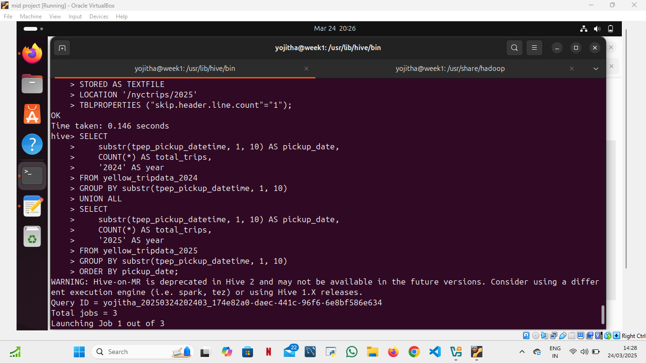
Problem 1: How do daily trip volumes compare between January 2024 and January 2025?
Observed Results:
The daily trip counts mostly fall within the range of around 80,000 to 110,000 trips for the bulk of January, though there are a few entries with extremely low counts (e.g., early dates like “2002-12-31”, “2009-01-01”, “2023-12-31”, and “2024-02-01”) which appear to be outliers or artifacts.
When comparing January 2024 with January 2025, the volumes are more in magnitude with some days in one year higher than the other. Cumulatively 2025 are greater than 2024.

Slide 6
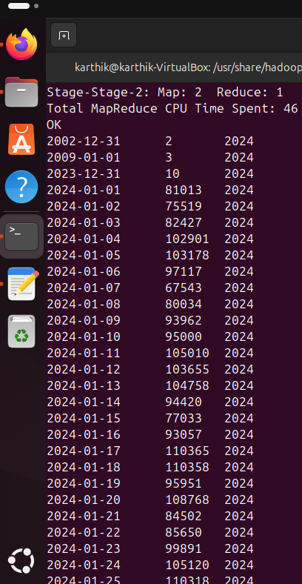
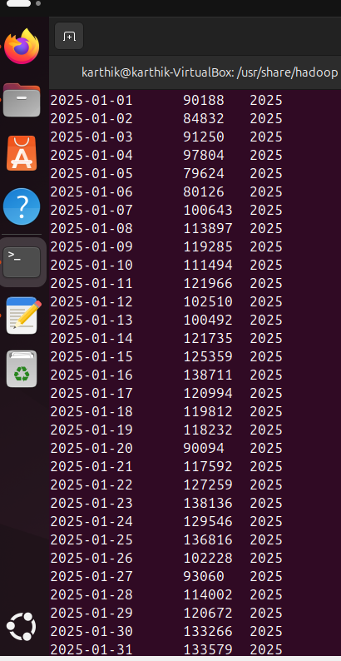

Slide 7
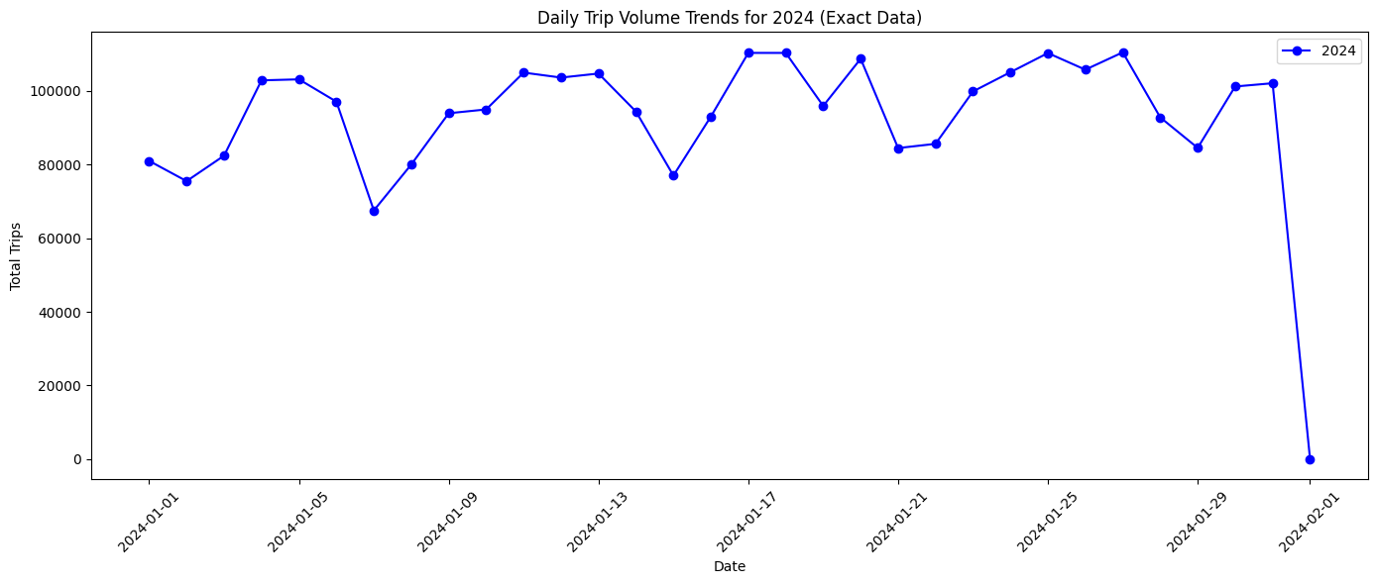
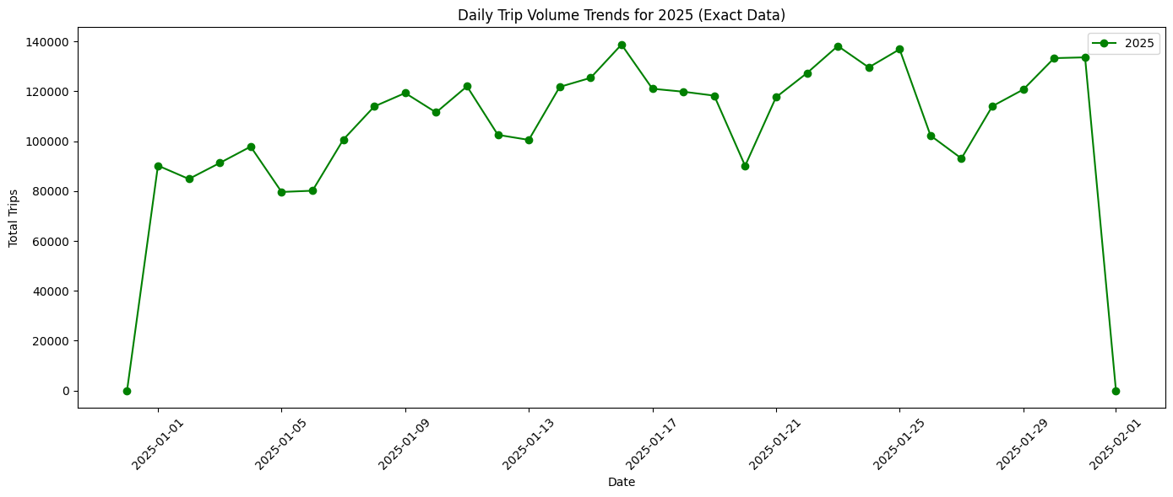

Slide 8
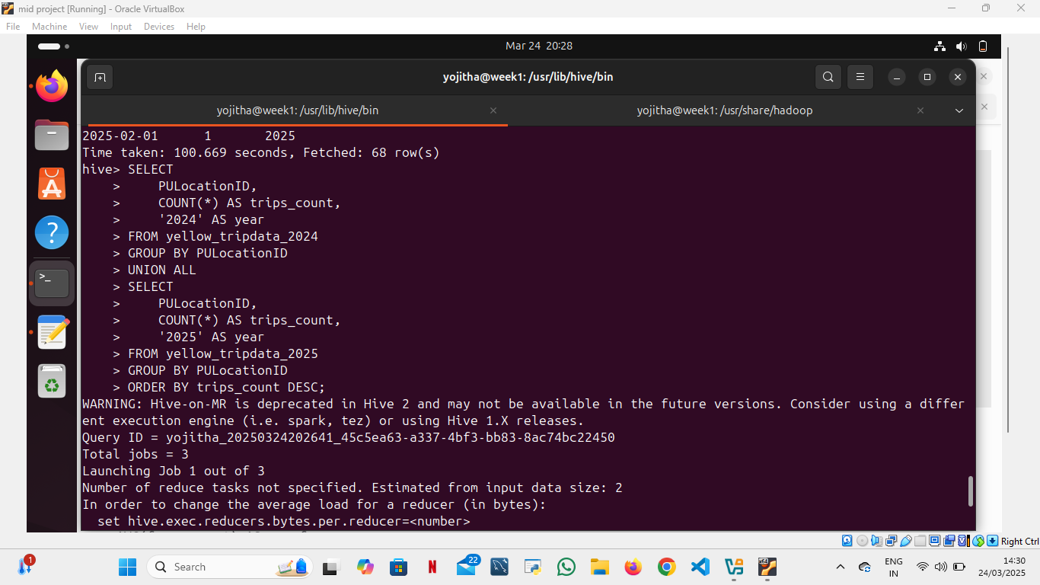
Problem 2: Which pickup locations (PULocationID) have the highest trip counts, and do these change from 2024 to 2025?
Observed Results:
The results list pickup location IDs (PULocationID) with their corresponding trip counts. Certain location IDs (for example, 161, 237, 236) show particularly high trip counts, indicating that these are major demand hubs.

Slide 9
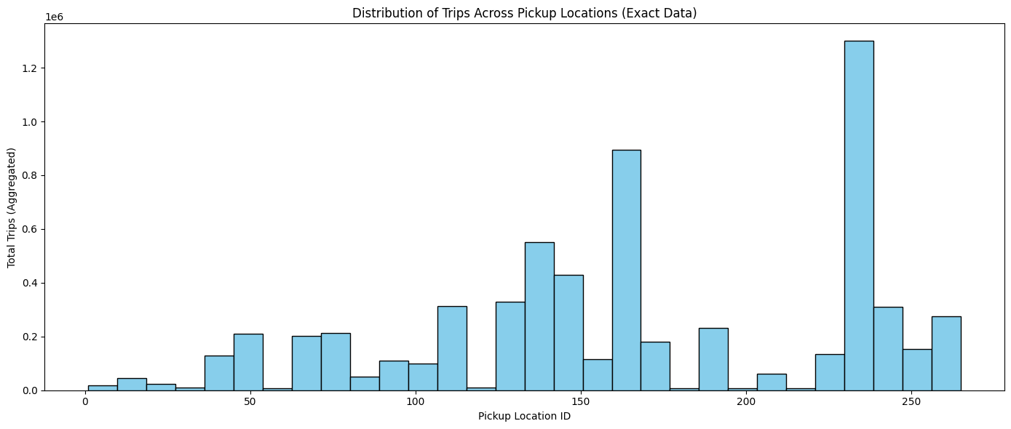

Slide 10
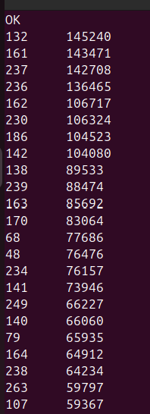
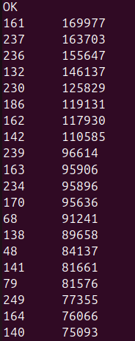
Year 2024
Year 2025

Slide 11
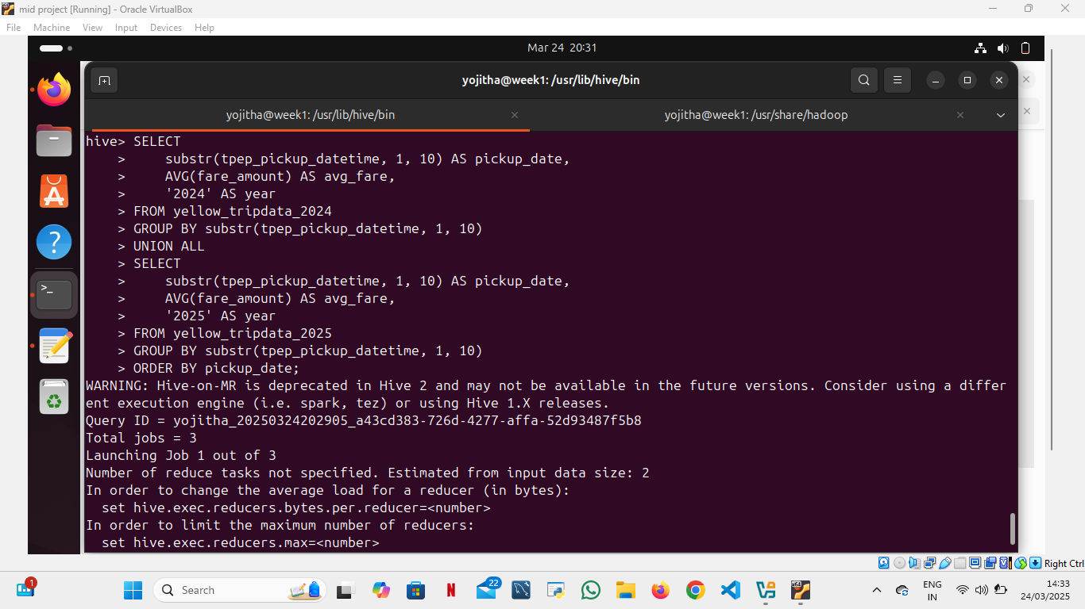
Problem 3: How do average fares per day vary between January 2024 and January 2025?
Observed Results:
The daily average fares tend to hover around the mid to high teens in US dollars, with most days falling in the 16–19 USD range. However, there are occasional spikes (e.g., a value of 33.33 USD on one day) and very low values (such as 0 or 6.5 USD), which might be outliers.
Later in the analysis we found that those 2 spikes in the year 2025 are special days which is New Year and Dr. Martin Luther King Jr Day. Every special days there could be a rise the prices.

Slide 12


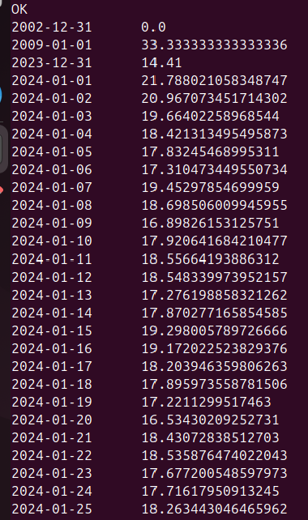
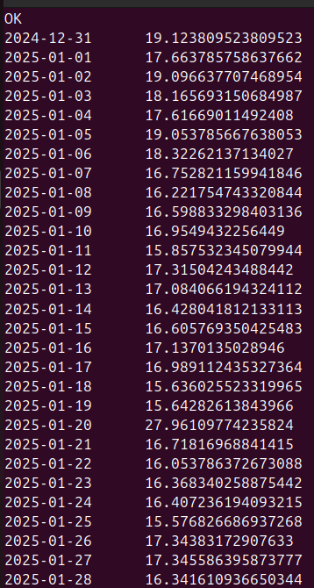
Year 2024
Year 2025

Slide 13
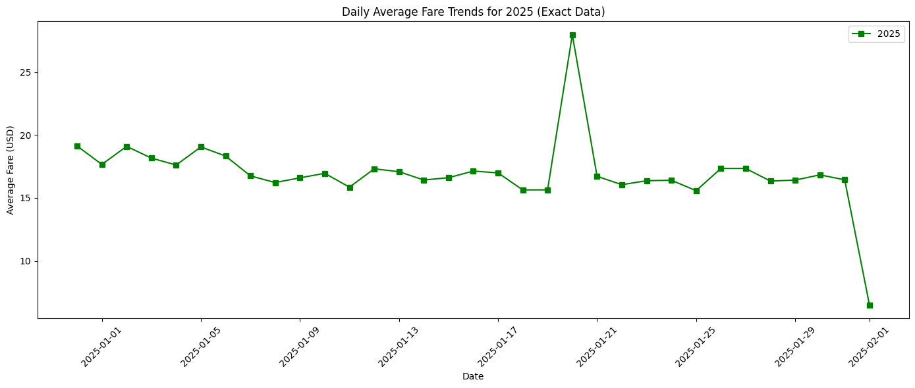
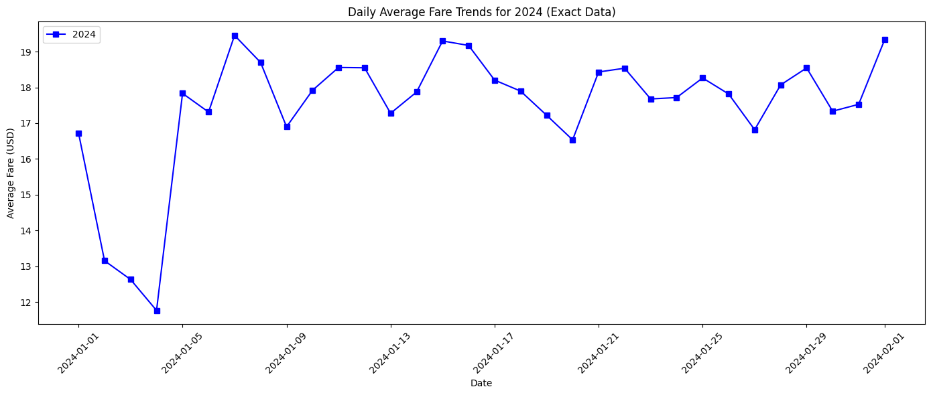

Slide 14
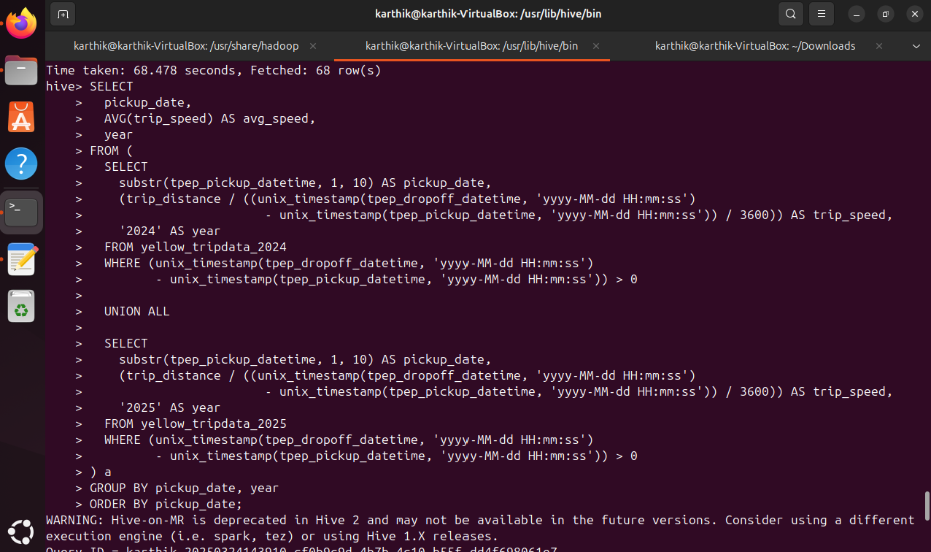
Problem 4: What are the average trip speeds, and how do they reflect traffic or operational efficiency differences between the two periods?

Slide 15
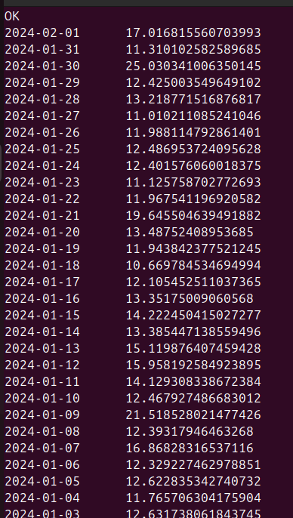
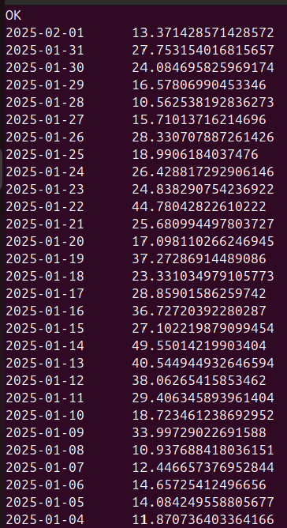
Year 2024
Year 2025

Slide 16
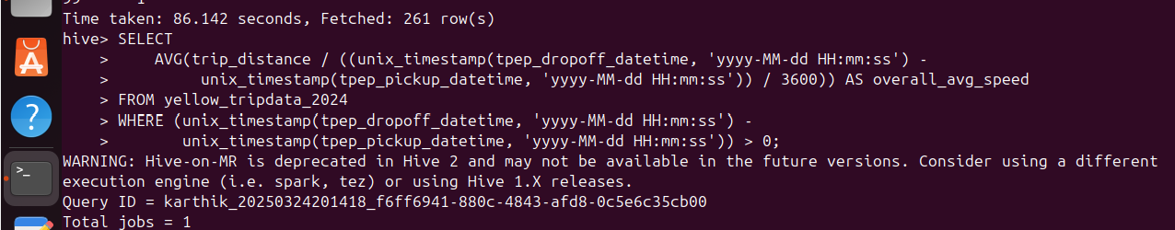
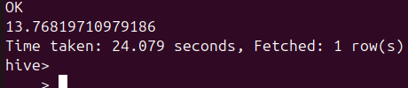
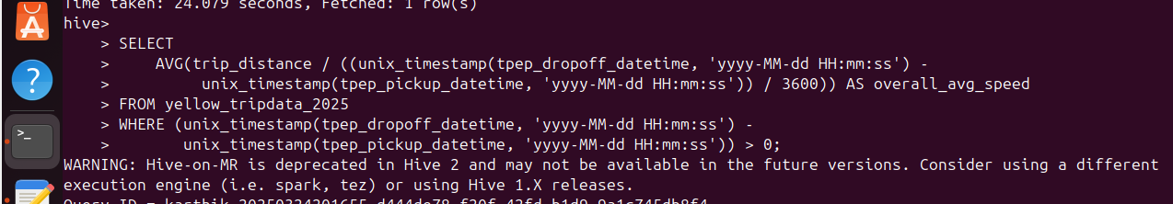

For 2024
For 2025

Slide 17

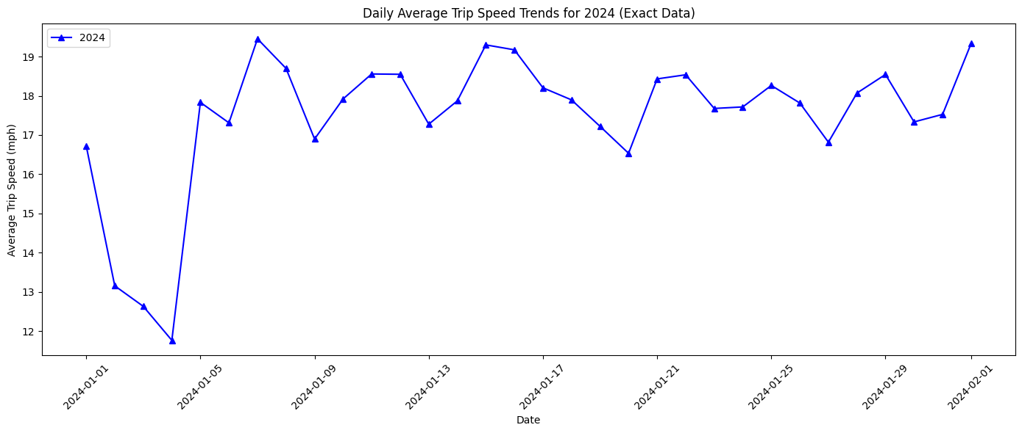

Slide 18
Thank you

